Slide 1
Capstone Exploration Project
By Mattias Ehatamm

Slide 2
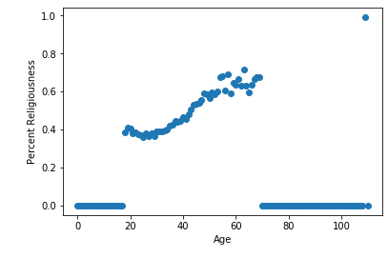
Exploring the Dataset through Graphs
To start the project, I had a few ideas based on studies I had seen in the news recently. One of them was the declining religious faith of more recent generations. To quantify this, I had to find a way to break the dataset into explicit halves of religious or nonreligious. I added a new column to the DataFrame called religious_code, which contained a 0 if the religion of the user was agnosticism or atheism, and a 1 if otherwise. I then grouped the DataFrame by age, and found out what percent of each age group was religious, shown in the graph on the left. From this graph, you can see a clear trend in religiousness among the older generations, although inhibited by the large amount of age groups that didn’t have a single entry. Interestingly, the oldest person in the dataset at 110 years old did not list themselves as religious.

Slide 3
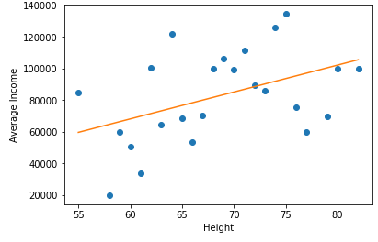
Exploring the Dataset through Graphs cont.
Next, I remembered a study i had seen which claimed that taller people were generally more successful due to being seen as more intimidating. I decided to group the dataset by height (after cleaning out a number of joke answers) and find the average income of each group of heights. Because of ~90% of users not listing their incomes and very few users at some heights, the results ended up being extremely variable. Shown on the left, the data varies greatly but shows a general trend upwards as height increases, shown by the regression line. However, some of this can be attributed to the wage gap between men and women and the fact that men are generally taller, leading to greater heights having greater incomes due to the wage gap.

Slide 4
Quantified Columns
In order to use regression on a number of the data columns, I had to quantify them through mapping. Mapped columns were:
Diet_Code, diet transformed to a scale of 1-5 based on freedom of diet
Religious_Code, religion mapped to 0 or 1, with 0 being atheism or agnosticism, and 1 being everything else
Drinks_Code, drinks mapped to a scale of 1-4 based on freedom of drink
Drugs_Code, drugs mapped out to 1-3 based on freedom of drug use
Smokes_Code, smokes mapped out to 1-5 based on freedom of smoking
Body_Type_Code, body_type mapped out to 1-4 based on lack of fitness

Slide 5
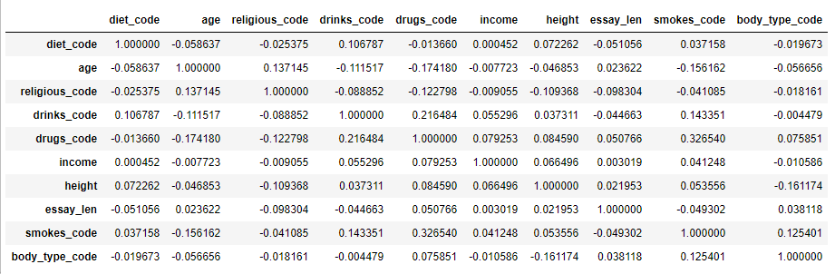
Correlations to Create a Question
Having created a number of new quantified columns, I added them to the previously available numerical ones, normalized them, and took the correlation matrix, shown below. Most notable of these correlations were the strong positive correlation between freedom of smoking and freedom of drug use, the strong negative correlation between age and freedom of drug use, and the strong negative correlation between religion and freedom of drug use. Perhaps the most interesting result of the matrix is the seemingly strong association between height and drug use. This is likely due to how much height is died to sex, and through the fact that males are more likely to use drugs. Noticing the multiple strong correlations associated with drug use, I decided to see if I could find the true association between these through regression.

Slide 6
Regression Approach 1
For the first regression approach for determining freedom of drug use, I used the basic form of multiple linear regression. Counting only the most strongly correlated variables, I constructed a regression line with the variables of “age, religious_code, drinks_code, height, smokes_code, and body_type_code” to the following results:
Looking at the accuracy score, it is clear that this method is not accurate at all in predicting freedom of drug use. The strongest factors are lack of inhibition in terms of drinking and smoking, with the other variables having surprisingly little effect. Much of the lack of accuracy may be due to the fact that there were only three possible values for drugs_code, given the three different answers to the question on OKCupid, making it harder for the prediction to be numerically close to the true value. Additionally, adding more variables increased the total number of NaNs in the dataset, and requiring more rows to be dropped, resulting in a smaller sample size.

Slide 7
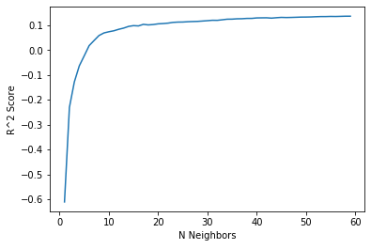
Regression Approach 2
Apart from multiple linear regression, a second strong approach to determining drug use is K Nearest Neighbors Regression. Using the same variables as MLR, I first graphed the effectiveness of varying n-neighbors variables using uniform weights. Although I didn’t explore higher values of n, the scores seemed to plateau at a R² score of about 1.4, so I chose a value of n=57. Interestingly, lower values of n produced a negative R² score, meaning that the regression line produced was so bad at predicting the drug_code values that a horizontal line would have performed better.

Slide 8

Regression Approach 2 Cont.
Using K-Nearest-Neighbors Regression, a n-value of 57, and uniform weights, the regressor was fitted to the variables of “age, religious_code, drinks_code, height, smokes_code, and body_type_code” to the following results:
Compared to the R² of ~.127 of MLR, this form of data analysis provides slightly better results, and his such a low accuracy due to all of the same reasons discussed in the MLR approach. However, as far as time goes, KNN Regression with such a high N value takes over 38 times more time to run than MLR. This points towards the complexity of KNN, and is extremely inefficient if iteration is necessary. This was very evident when I was finding the optimal N value for the regressor, and the calculations took well over a minute.

Slide 9
Classification
For classification, it was necessary to find a more qualitative, black-and-white statistic to try and classify rather than the range that was drug use. Having dismissed a correlation earlier in my examinations as a result of the wage gap, I decided that it would be interesting to see if I could predict sex from height and any other factors.
Looking at the correlations, height is possibly the most strongly correlated variable with sex out of any two variables in the dataset. Income is less so, but still has a skew towards males, indicating a hint of a wage gap. Together, these two variables should be relatively strong in classifying users as male or female.

Slide 10
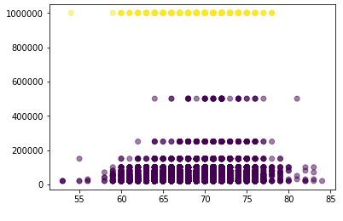

Classification Approach 1
Using Income and Height to differentiate, I fitted a KMeans classifier to the dataset, and allowed it to separate the data into clusters. Shown on the left is a graph of the data with the x-axis representing height and the y-axis representing income. Compared to the correct values of male or female, the KMeans classifier produced a surprisingly high accuracy of .706. However, the process took nearly a full second, a suspiciously long time.

Slide 11

Classification Approach 2
The second form of classification that I decided to use was K Nearest Neighbors classifying. After some experimenting, I found that the optimal amount of N Neighbors to use was 5, and I was given surprisingly positive results.
With such high accuracy and low elapsed time, KNN proved to be a truly efficient way of proving the association between sex and height+income. Because of the low N value, the classifier works quickly compared to the K Neighbors regressor earlier in the exploration, which had an N value of 57.

Slide 12
Conclusions
As a conclusion to the question posed about prediction of drug use, KNN regression was able to predict it with at best very low accuracy. However, this doesn’t mean that freedom of drug use was unpredictable, but the circumstances surrounding the regression made it difficult. The normalized drug use scale only had three possible values, something that the regressor couldn’t account for, reducing accuracy. Additionally, the more columns that were used as variables, the more NaNs were present in the table. This resulted in less total rows, and a smaller sample size leading to more volatile data. The most prominent of these NaN-abundant variables was income, which had nearly 90% of users choosing not to answer. This didn’t stop the classifier from producing reasonable results, though, with both of the classification approaches producing relatively high accuracies. To produce more accurate results though, having all of the users provide answers to all of the questions would greatly simplify processes. Other questions that are possible from this dataset include the seeming lack of association between diet and body type, and analysis of what different types of data different religions tend towards, rather than simply grouping them into religious or nonreligious. Overall, though, freedom of drug use can be inconsistently predicted from freedom of smoking, diet, age, religion, and strangely, height. Sex, however, can be very consistently predicted from simply the two factors of height and income. This is not completely telling, though, as height played much more of a part in the calculations than income did, so it is possible that income is not at all useful in predicting sex.

